Slide 1
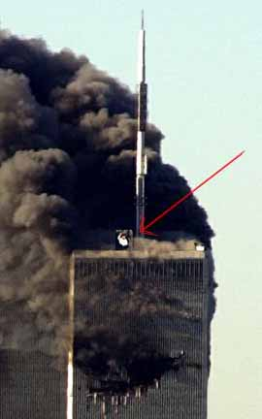
zoom
What is this figure?
FBI investigators have discovered through witnesses that there was a warning signal in the World Trade Center

Slide 2
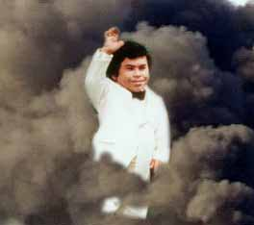
”De Plaaaaaane.... De Plaaaaaane……..

